Slide 1



BULLETIN
FROM THE PHOTO CONTEST
"I LOVE MOVEMENT" ,UNDER THE SPORTS FOR GREEN DEAL PROJECT, 101090711,
ERASMUS SPORT PROGRAMME

Slide 2



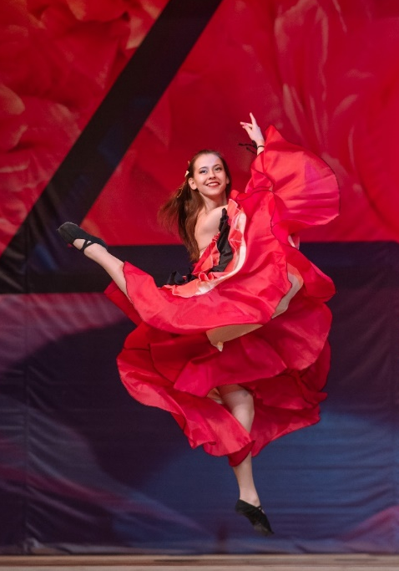
Selected photos from the "I love movement" photo contest
The competition was held in the period August 9 - September 8, 2023 within the Sport for the Green Deal project, funded by the ERASMUS SPORT Programme, implemented by the Municipality of Ruse. The presented selection shows different perspectives on sports and outdoor activities for an active lifestyle as a desirable and attractive activity. On the topic: "I love movement", we received 60 works from 19 authors. Here we show 10 of them.
“The Dance 3” by Peter Dimitrov,
Annual production of "Diva Dance" formation, Kazanlak, 2021.

Slide 3
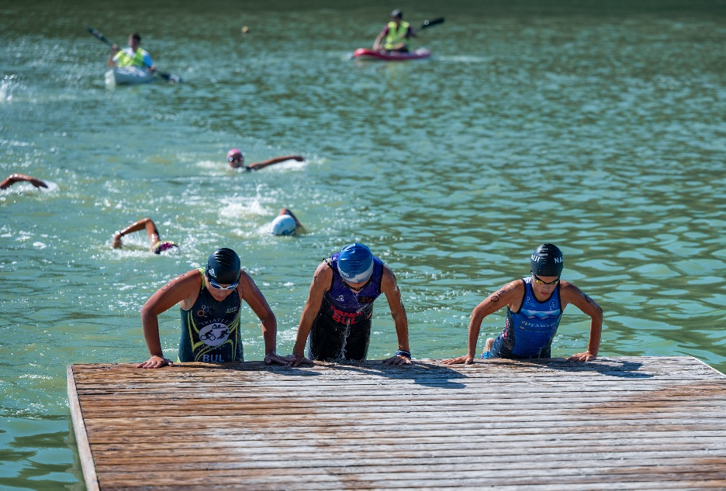
I prize, “Contested race", by Desislava Nikolova
The photo was taken during the international "Ruse" cup competition in triathlon, held on 29-30.07.23 at Nikolovo lake.

Slide 4
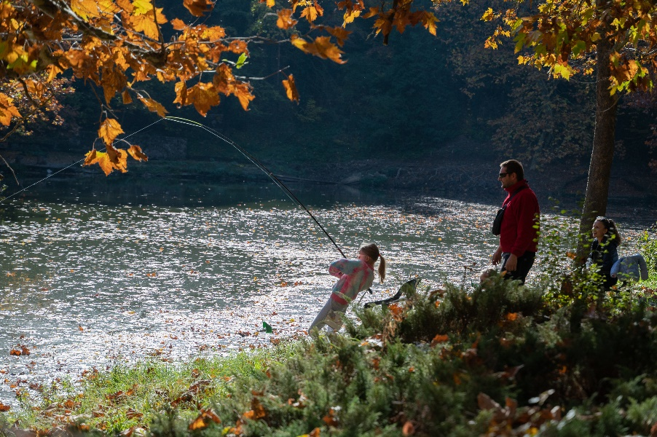
II prize, “Like daddy“, by Shirin Dzhavidova
A shot from a sport fishing competition at Lesopark "Lipnik", 2022.

Slide 5
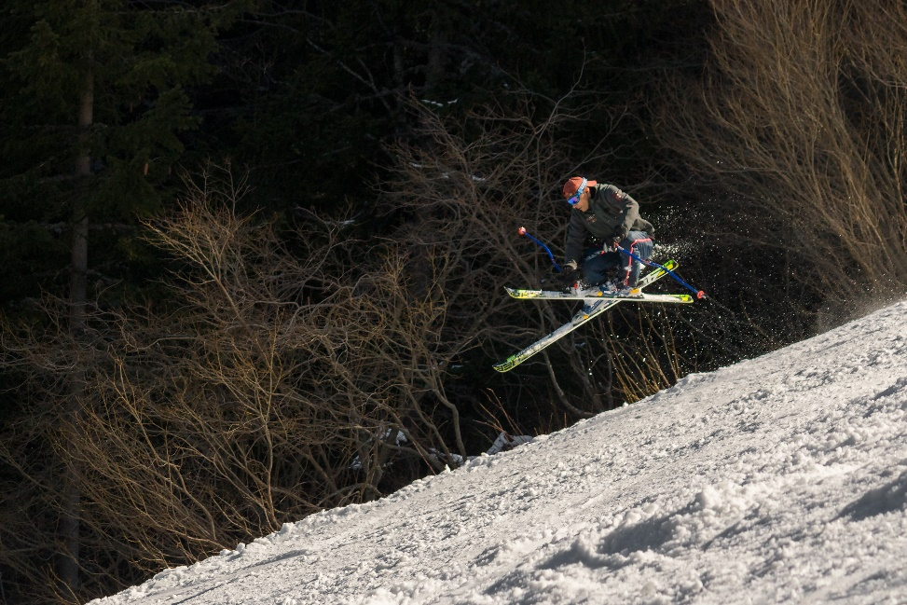
III prize, „Jump“, by Vanya Tonova
Photo of the author's husband on the "Laleto" ski slope on Vitosha, March 2023.

Slide 6
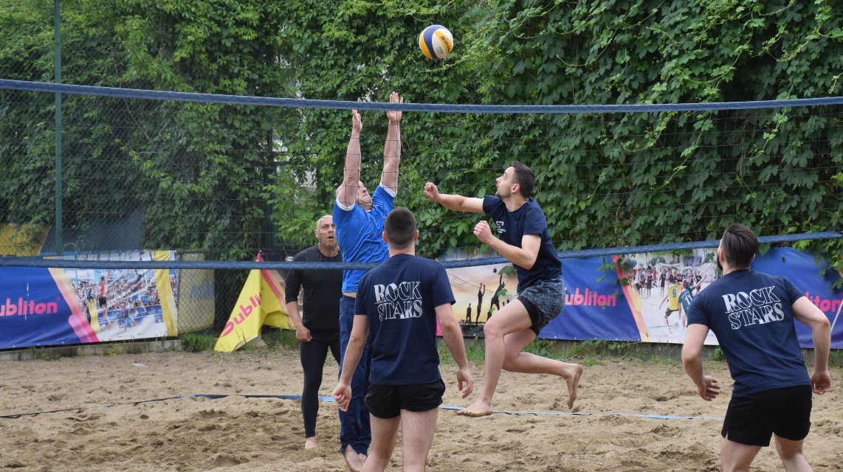
„Pressure at the network", by Alexander Nedelchev
The photo was taken during the "Workers' Sports Festival", 2023.

Slide 7
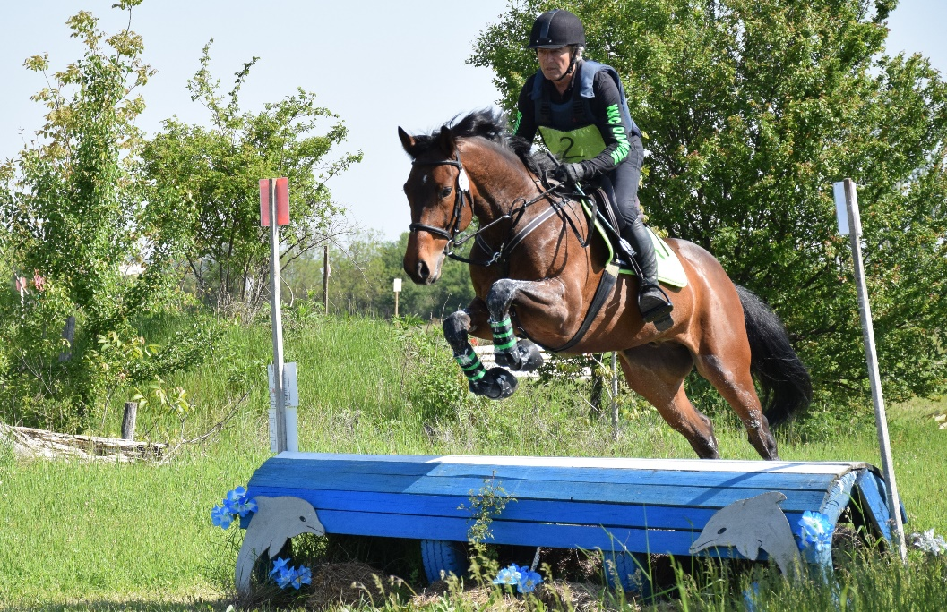
„Impetus", by Milena Nedelcheva
Photo from the 2023 State Eventing Championships.

Slide 8
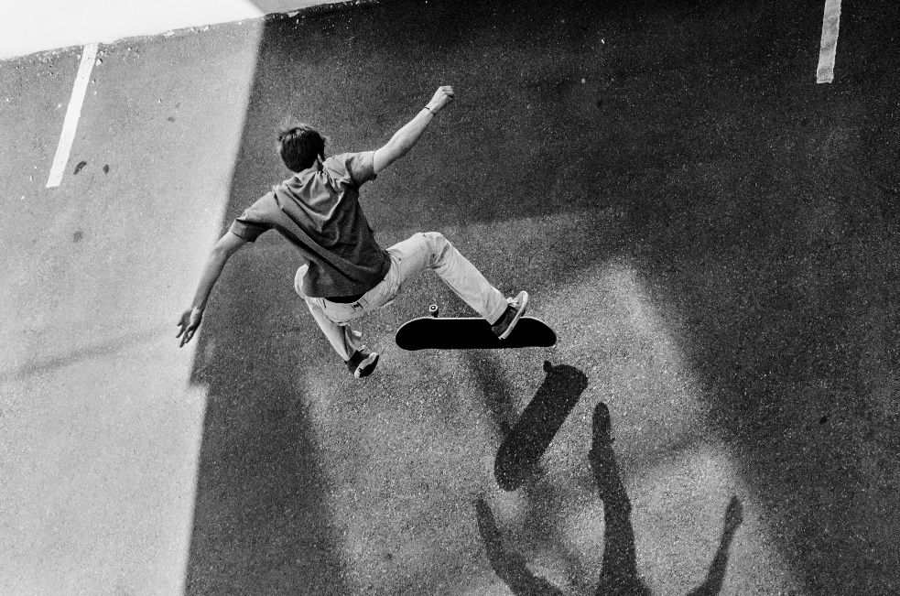
„Running away from the shadow“, by Desislava Ignatova
Children riding skateboard under the windows of an apartment block, Sofia 2022

Slide 9
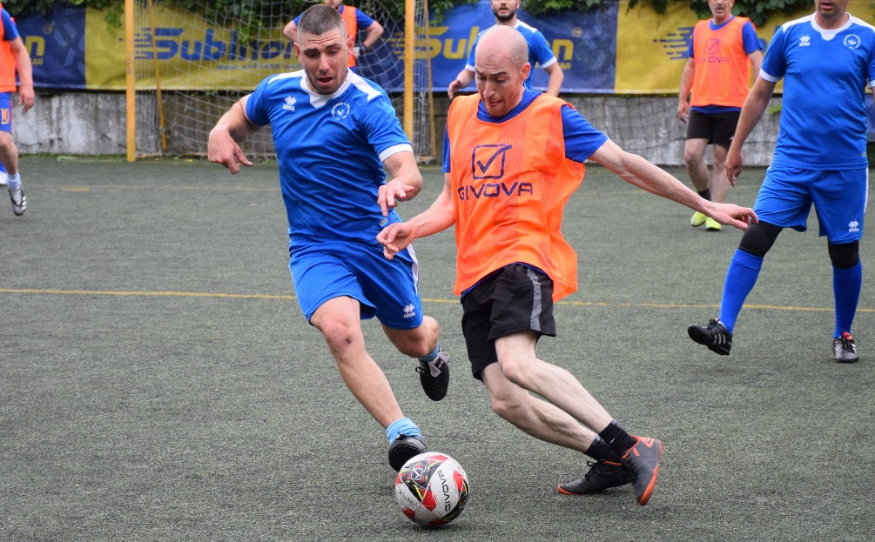
„Hot ball“, by Boyan Yordanov
A photo from the "Workers' Sports Festival", 2023.

Slide 10
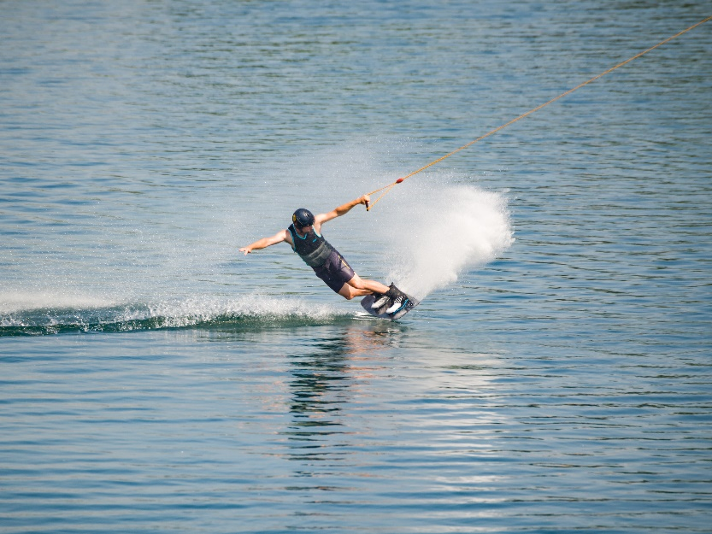
“Wakeboarding“, by Hristo Kolev
The picture was taken on Danube at Vienna on a wakeboarding facility, 2022.

Slide 11
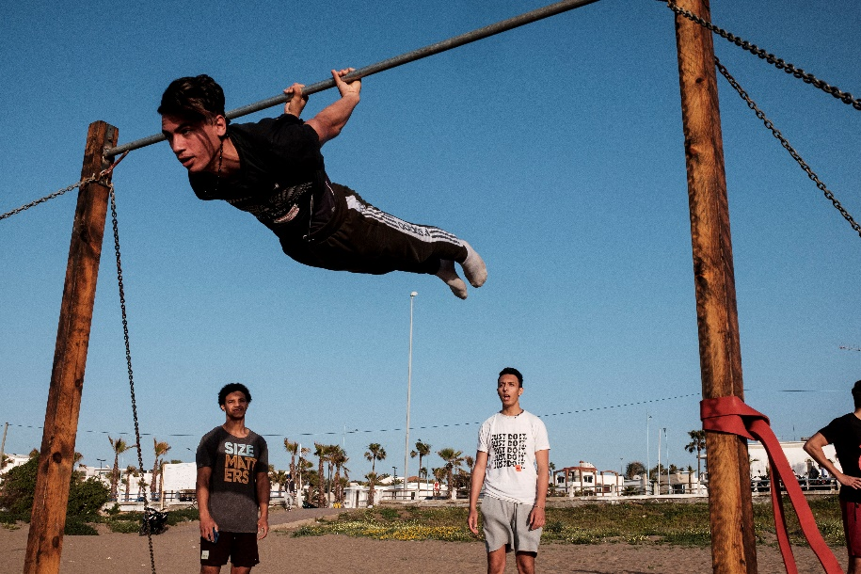
“Acrobatics“, by Asen Georgiev
At open air fitness in Casablanca (Morocco) a group of young people show enviable acrobatic skills, 2022.

